Slide 1
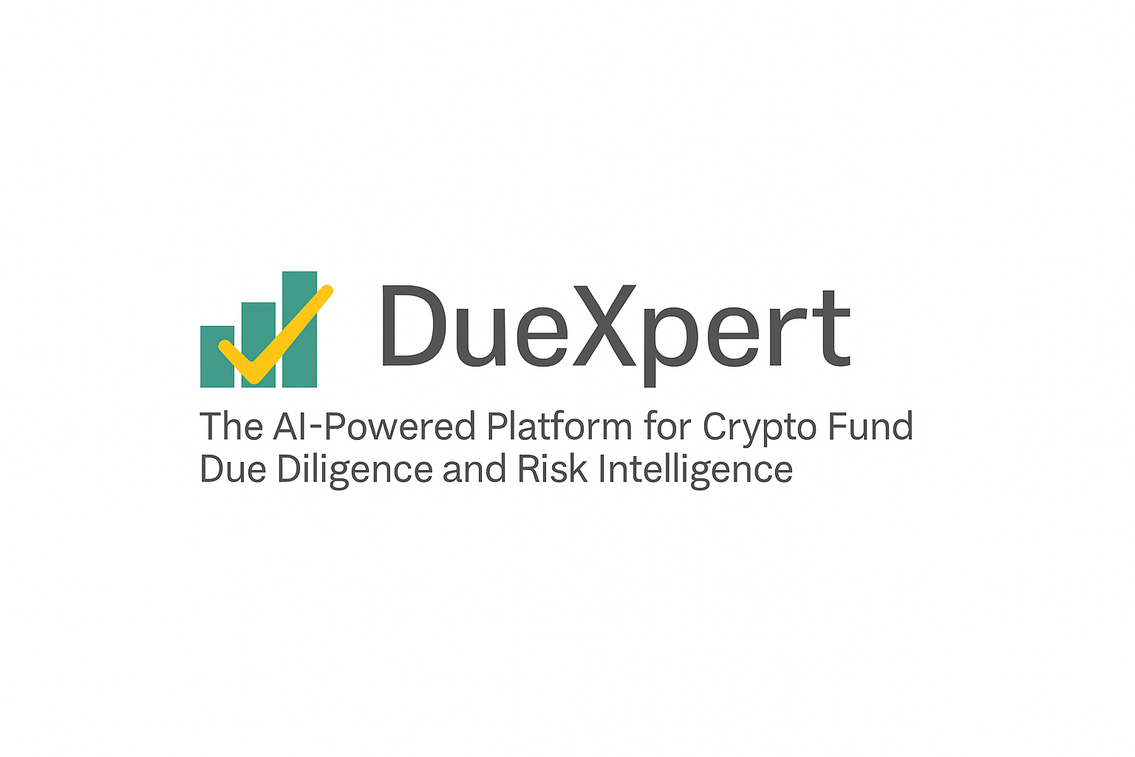
Due Diligence Report
Prepared by DueXpert | 2025-04-25
DueXpert – AI Crypto Fund Due Diligence Suite | info@duexpert.ai | www.duexpert.ai

Slide 2
CONTENTS
1. AML / KYC
3
2. COMMUNITY & UX
4
3. CUSTODY & ASSET SECURITY
5
4. CYBERSECURITY & DATA PRIVACY
6
5. ESG & SUSTAINABILITY
7
6. FINANCIAL HEALTH
8
7. GOVERNANCE
9
8. IP & CONTRACTS
10
9. LEGAL & REGULATORY
11
10. RISK MANAGEMENT
12
11. STRATEGY & COMPETITIVE POSITIONING
13
12. TECHNOLOGY & INFRASTRUCTURE
14
13. TOKENOMICS & TRADING INTEGRITY
15

Slide 3
3. AML / KYC
Objective: Ensure the company has robust Anti-Money Laundering (AML) and Know Your Customer (KYC) policies and compliance in place.
Key Findings:
• The provided text does not mention specific anti-money laundering (aml) policies and procedures.
Outstanding Issues:
DueXpert – AI Crypto Fund Due Diligence Suite | info@duexpert.ai | www.duexpert.ai
Page 3

Slide 4
4. Community & UX
Objective: Assess user engagement, platform usability, and transparency of communication with the community.
Key Findings:
• There is no mention of a codebase being open-source or proprietary in the provided text.
• The document does not provide an in-depth evaluation of the user-friendliness of the cryptobazar fund's platform.
• Unfortunately, there isn't much information about the community around the cryptobazar fund project in the provided text.
• There is no mention of a specific customer feedback mechanism in the provided text.
• Yes, according to the provided text, there is a mechanism for feedback and communication.
Outstanding Issues:
DueXpert – AI Crypto Fund Due Diligence Suite | info@duexpert.ai | www.duexpert.ai
Page 4

Slide 5
5. Custody & Asset Security
Objective: Evaluate how the company stores and secures digital assets and whether custody mechanisms are robust.
Key Findings:
• The document doesn't explicitly mention how digital assets are stored and secured.
• Unfortunately, i do not see a mention of multi-signature wallets in the provided text.
• Unfortunately, i do not see any specific information on how the cryptobazar fund verifies asset ownership.
• The provided text, the following procedures for buying and selling digital assets can be inferred: **buying digital assets:** 1.
• The document, digital assets are valued in two ways: 1.
Outstanding Issues:
DueXpert – AI Crypto Fund Due Diligence Suite | info@duexpert.ai | www.duexpert.ai
Page 5

Slide 6
6. Cybersecurity & Data Privacy
Objective: Examine the strength of cybersecurity practices and safeguards for user and company data.
Key Findings:
• Unfortunately, the text does not mention a specific blockchain technology being used by the cryptobazar fund.
• Unfortunately, i don't see any specific information regarding cybersecurity measures mentioned in the provided text.
• Unfortunately, i couldn't find any information in the provided text that directly answers your question about whether two-factor authentication and end-to-end encryption are used. however, the provided text is a comprehensive document outlining the terms and conditions of the cryptobazar fund.
• There is no mention of how the company handles user data privacy in the provided text.
• There is no mention of a specific data protection policy in the provided text.
Outstanding Issues:
DueXpert – AI Crypto Fund Due Diligence Suite | info@duexpert.ai | www.duexpert.ai
Page 6

Slide 7
7. ESG & Sustainability
Objective: Evaluate the company’s environmental, social, and governance practices and long-term sustainability impact.
Key Findings:
• Based on the provided document, it appears that the revenue diversification is not explicitly discussed.
• There is no mention of initiatives to reduce energy consumption in the provided text.
• There is no mention of sustainability practices or policies in the provided text.
• There is no mention of environmental concerns in the provided text.
• The cryptobazar fund contributes to the overall cryptocurrency ecosystem in several ways: 1.
Outstanding Issues:
DueXpert – AI Crypto Fund Due Diligence Suite | info@duexpert.ai | www.duexpert.ai
Page 7

Slide 8
8. Financial Health
Objective: Ensure the company’s financial statements, cash flows, and projections reflect a healthy financial position.
Key Findings:
• Based on the provided text, there is no specific mention of "disputes" that could lead to potential financial exposures.
• The answer is not explicitly mentioned in the provided text.
• The document provided does not contain comprehensive financial information about the company's financial health.
• There is no mention of tax disputes or pending issues in the provided text.
• The text does not explicitly mention how frequently financial reports are published.
Outstanding Issues:
DueXpert – AI Crypto Fund Due Diligence Suite | info@duexpert.ai | www.duexpert.ai
Page 8

Slide 9
9. Governance
Objective: Assess decision-making structure, roles of stakeholders, and board oversight processes.
Key Findings:
• After analyzing the provided text, i did not find any explicit mentions of potential conflicts of interest among stakeholders.
• Yes, according to the text, there is information about the following people involved in the cryptobazar fund: * managing partners: they are responsible for carrying out deals and transactions with assets, and making decisions on behalf of the co-investors. * co-investors (also referred to as investors): these are individuals who have invested in the fund and share in its risks and potential returns. however, there is no mention of "developers" being specifically engaged.
• Based on the provided document, it appears that the governance structure of the cryptobazar fund is as follows: * **managing partners**: they are responsible for carrying out deals and transactions with assets without the instruction or consent of co-investors.
• The text, the managing partners have decision-making power in the fund.
• Based on the provided text, the major stakeholders in the cryptobazar fund are: 1.
Outstanding Issues:
DueXpert – AI Crypto Fund Due Diligence Suite | info@duexpert.ai | www.duexpert.ai
Page 9

Slide 10
10. IP & Contracts
Objective: Evaluate the clarity of intellectual property (IP) ownership and the contractual integrity of the business.
Key Findings:
• Based on the provided text, there is no information about the company owning any intellectual property (ip) assets.
• After reviewing the provided text, i did not find any specific information about intellectual property (ip) infringement issues.
• There is no mention of ip (intellectual property) rights in the provided text.
• The text does not explicitly mention whether smart contracts are audited for vulnerabilities.
• No, there is no mention in the provided text that the company contributes to open-source projects.
Outstanding Issues:
DueXpert – AI Crypto Fund Due Diligence Suite | info@duexpert.ai | www.duexpert.ai
Page 10

Slide 11
11. Legal & Regulatory
Objective: Ensure the company’s legal entity, licensing, and jurisdictional compliance are clearly established.
Key Findings:
• The provided document, the cryptobazar fund is a venture fund that invests in blockchain technology and cryptocurrencies.
• After reviewing the provided text, i did not find any information about significant changes in the legal structure of cryptobazar fund over time.
• There is no explicit mention of whether all necessary licenses and permits are in place.
• The provided text, it appears that there is no explicit mention of sanctions restrictions or transaction monitoring requirements.
• No, i don't see any information about ongoing or past legal disputes in the provided text.
Outstanding Issues:
DueXpert – AI Crypto Fund Due Diligence Suite | info@duexpert.ai | www.duexpert.ai
Page 11

Slide 12
12. Risk Management
Objective: Identify how the company manages internal and external risks, including business continuity.
Key Findings:
• There is no mention of "conflicts" in the provided text.
• Yes, according to the risk warning notice, there is a mention of "actions of state bodies or trading platforms that regulate russian and international securities market" as one of the risks that co-investors assume.
• A thorough review! based on the provided document, here are some potential concerns and questions: 1.
• The provided document, there is no explicit mention of specific risk management strategies for market volatility.
• Unfortunately, i don't see any information about a business continuity plan being mentioned in the provided text.
Outstanding Issues:
DueXpert – AI Crypto Fund Due Diligence Suite | info@duexpert.ai | www.duexpert.ai
Page 12

Slide 13
13. Strategy & Competitive Positioning
Objective: Understand the company’s business model, growth strategy, and differentiation in the market.
Key Findings:
• After carefully reviewing the document, i've identified some potential pain points and areas for improvement: 1.
• The text, the company, cryptobazar fund, has a strong market position in the cryptocurrency and blockchain technology investment space.
• The document doesn't explicitly mention specific competitors or market gaps, but it does provide some information that can be inferred: * the cryptobazar fund is positioning itself as an alternative to other ico investment options by entering projects before they launch their icos. * the fund's strategy of investing in pre-ico stages and providing preferential exit rights may be a differentiator from other funds or investors. * the market for cryptocurrency and blockchain investments is growing, but it is still relatively small compared to traditional financial markets.
• Based on the provided document, it appears that the digital strategy is not explicitly aligned with the business goals.
• There is no mention of specific hedging strategies in the provided text.
Outstanding Issues:
DueXpert – AI Crypto Fund Due Diligence Suite | info@duexpert.ai | www.duexpert.ai
Page 13

Slide 14
14. Technology & Infrastructure
Objective: Evaluate the scalability, reliability, and modernity of the company’s technological backbone.
Key Findings:
• Based on the provided text, it appears that there is no explicit information about the primary funding sources for the cryptobazar fund.
• The provided text, yes, there are plans for future scalability and growth.
• No, there is no mention of energy-intensive mining methods in the provided text.
• Based on the provided document, it appears that the project is likely a decentralized one.
• The provided text, the following technologies are mentioned: 1.
Outstanding Issues:
DueXpert – AI Crypto Fund Due Diligence Suite | info@duexpert.ai | www.duexpert.ai
Page 14

Slide 15
15. Tokenomics & Trading Integrity
Objective: Assess token issuance mechanisms, market manipulation controls, and valuation transparency.
Key Findings:
• Based on the provided documentation, it appears that the cryptobazar fund has not explicitly stated its compliance with relevant securities and commodities laws.
• There is no mention in the provided text of specific trade surveillance mechanisms to prevent market manipulation.
• The text does not explicitly state whether valuations are consistent with market standards.
• There is no mention of code reviews in the provided text.
• Unfortunately, there is no information in the provided text that directly addresses how the company ensures compliance with any specific standards.
Outstanding Issues:
DueXpert – AI Crypto Fund Due Diligence Suite | info@duexpert.ai | www.duexpert.ai
Page 15

